Slide 1
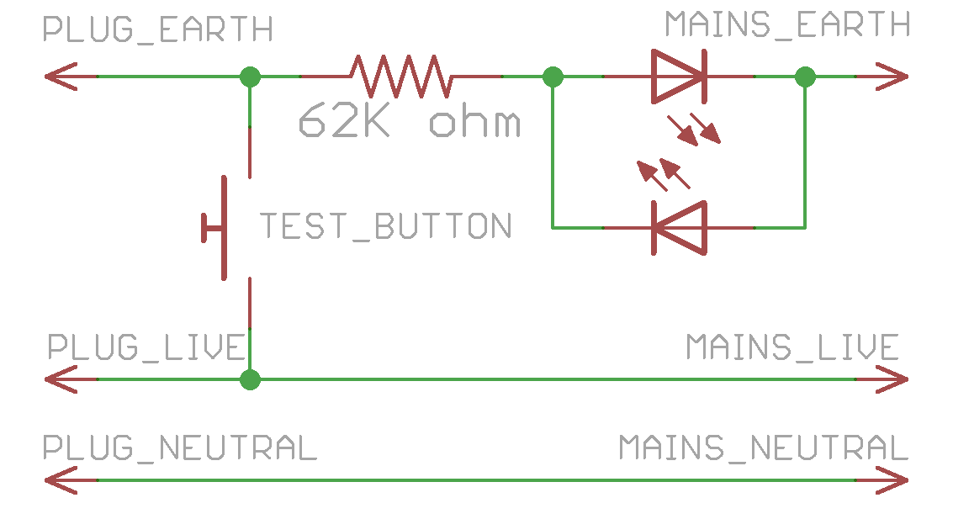
Anti-trip earth leakage detector instructions
1. Do NOT use without prior training or supervision.
2. Upstream power source must have a 10mA RCD/RCCB/RCBO. Always test before use.
3. ONLY use for suspected/high-risk of Earth-fault appliances.
4. Only connect ONE appliance at a time to test.
5. HANDS OFF appliance whenever you apply power with my tester.
6. Be ready to cut power immediately once the blue light comes on or if you notice abnormal behaviour in the appliance.
7. After repairing, plug the appliance to a conventional socket and verify that the breaker does not trip under normal circumstances.
8. ALWAYS TEST BEFORE USE
ALWAYS TEST BEFORE USE
Blue LED lights up -> earth fault
If in doubt, ask Kheng Meng ☺

